Slide 1
An interactive introduction to topological data analysis
Luke Wolcott
Lawrence University
4/8/2016

Slide 2
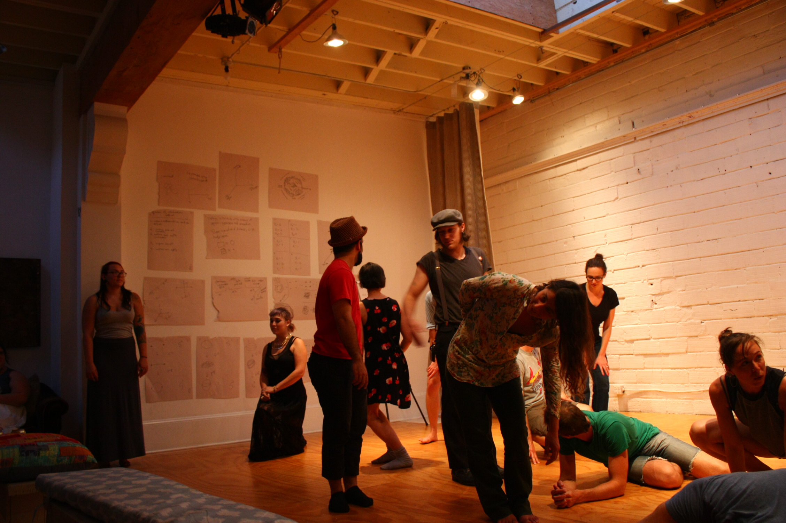
Bodies of Data Workshop
MAA MathFest, Portland 2014
Notes:
“interactive” but not in this sense
Collaboration with dancers to explore these ideas over a 4-day workshop
Data versus real life. Embodied. Digital versus analog.
Questions of surveillance, of privacy… YikYak, San Bernardino, etc

Slide 3
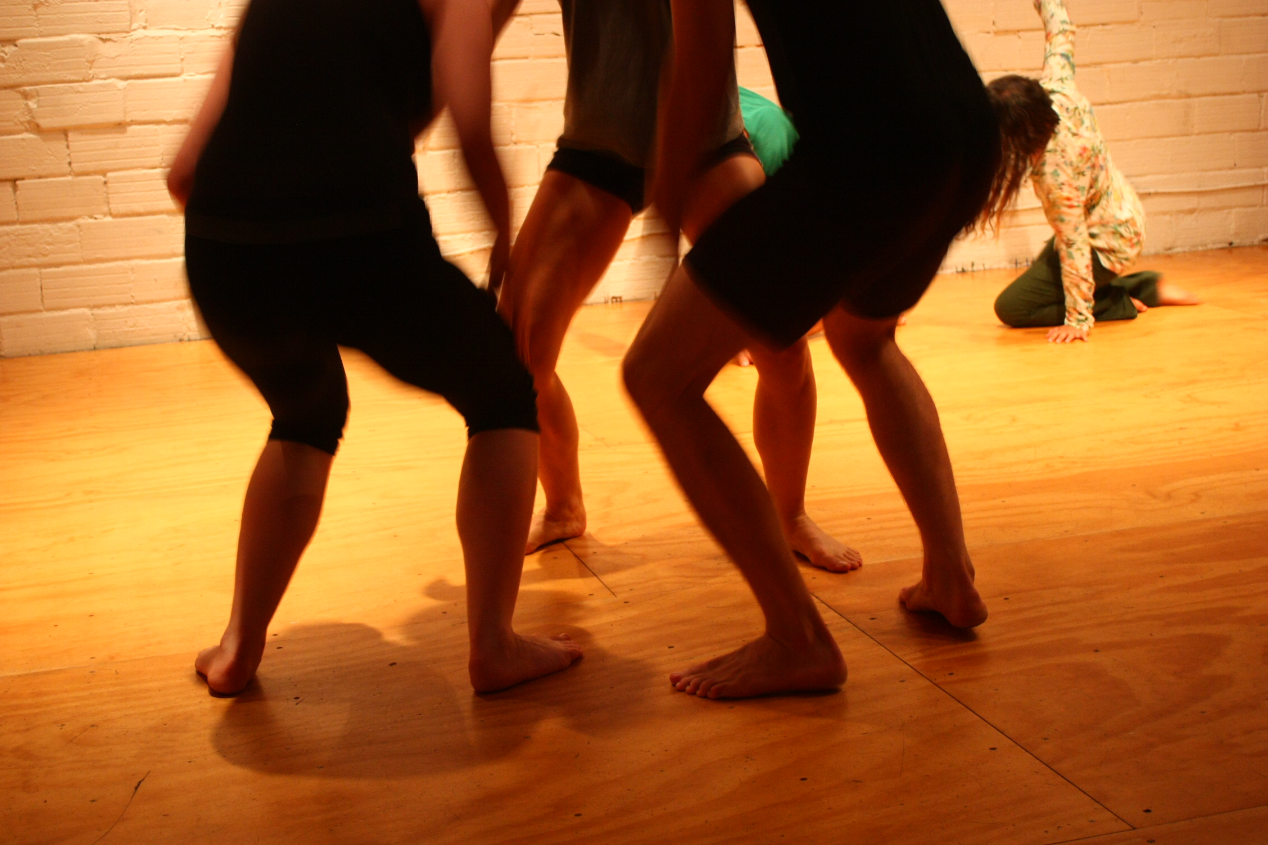

Slide 4
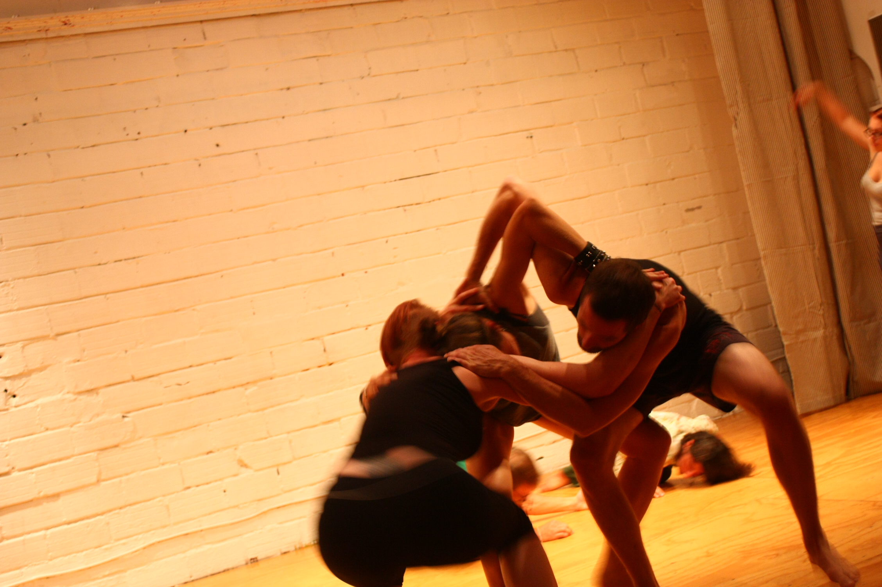

Slide 5
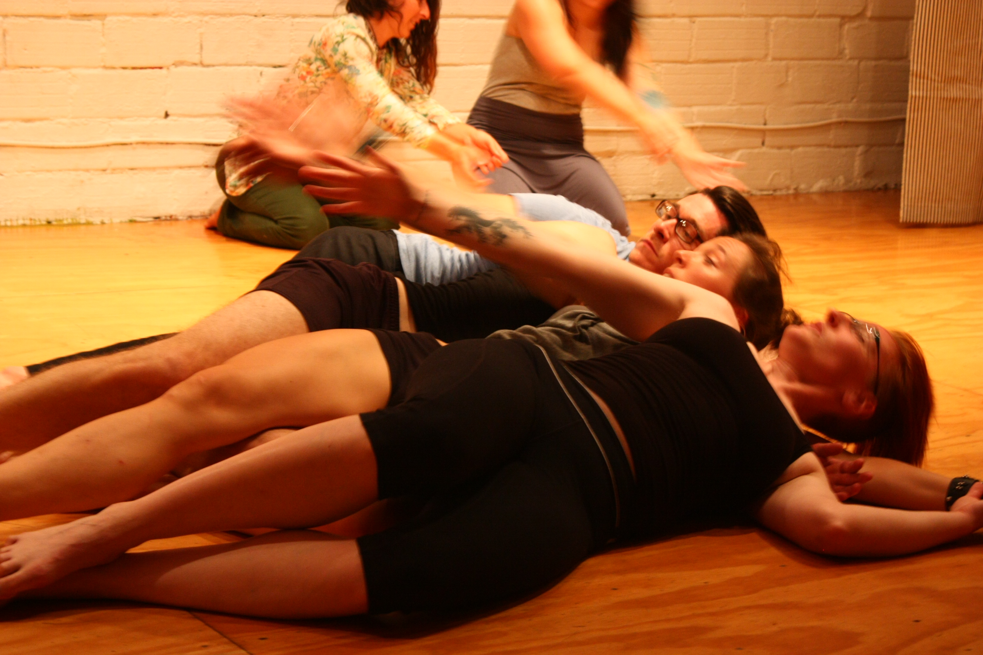

Slide 6
Muthu Alagappan, Stanford
2010-2011
452 NBA Players, 7 normalized statistics
Notes:
Not five positions, but 13.
Using rates (per minute played) of rebounds, assists, turnovers, steals, blocked shots, personal fouls, and points scored, we identified more playing styles than the traditional five.
Outline: What is TDA and why is it a good DA technique?
How does it work?
Demo with live data.
At end: go into weeds in one way or another.

Slide 7
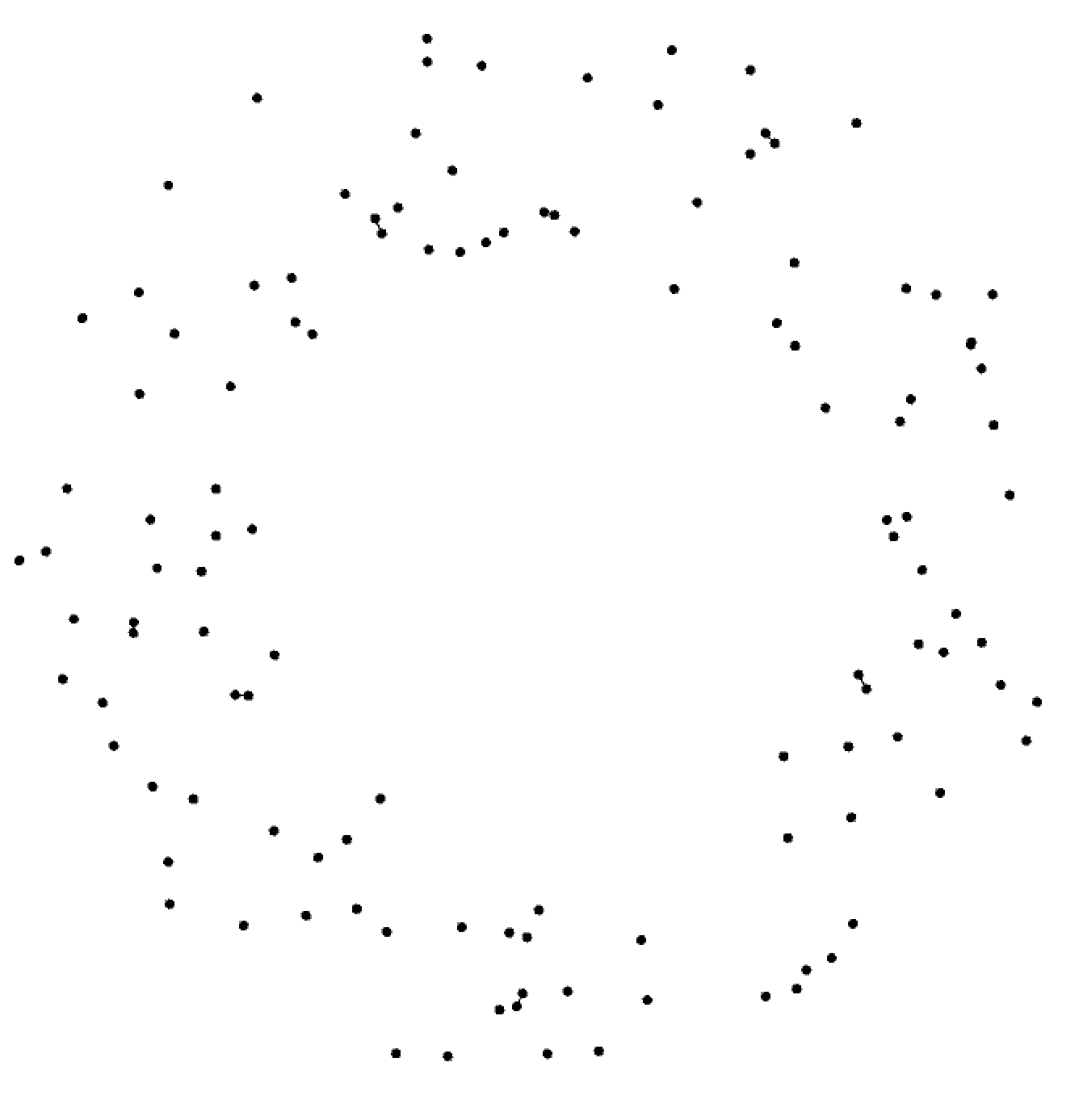
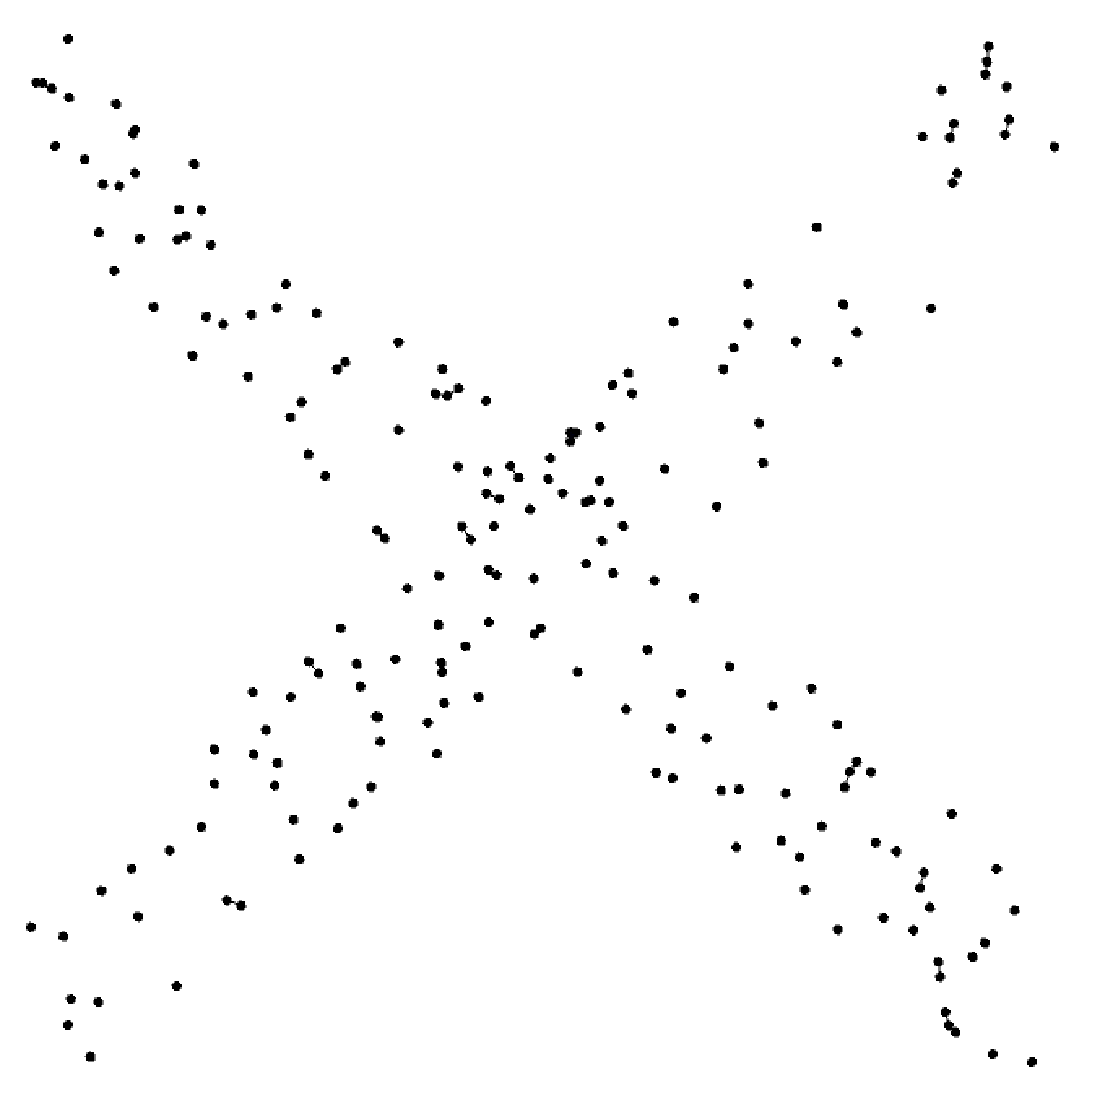
If your data form a high-dimensional point cloud, what is the shape?
Notes:
point cloud: different parameters, we can make one
What shapes do you see?

Slide 8
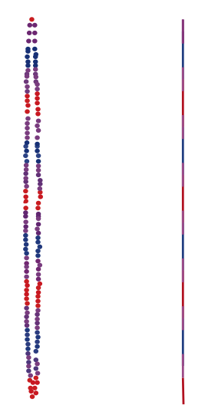
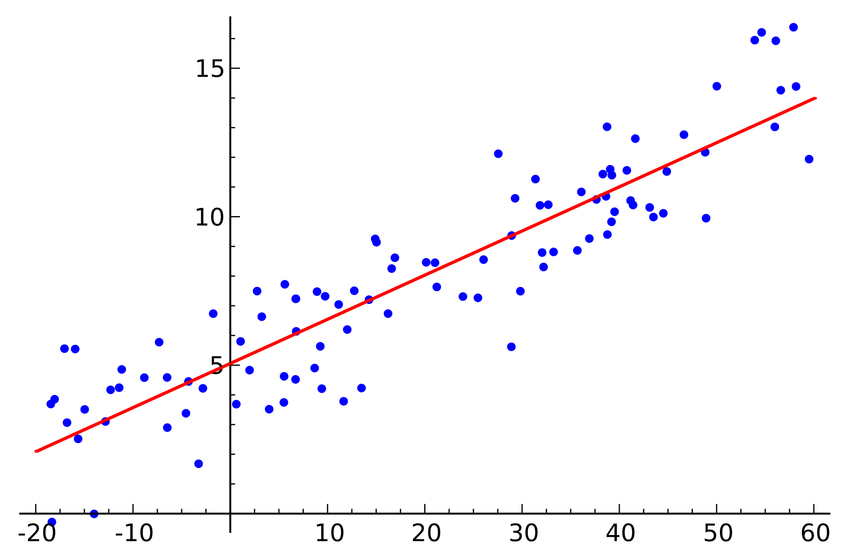
How is TDA different?
-- holistic/global: don’t have to select for features beforehand
-- scale-independent
-- robust to noise and deformation
-- unique insights

Slide 9
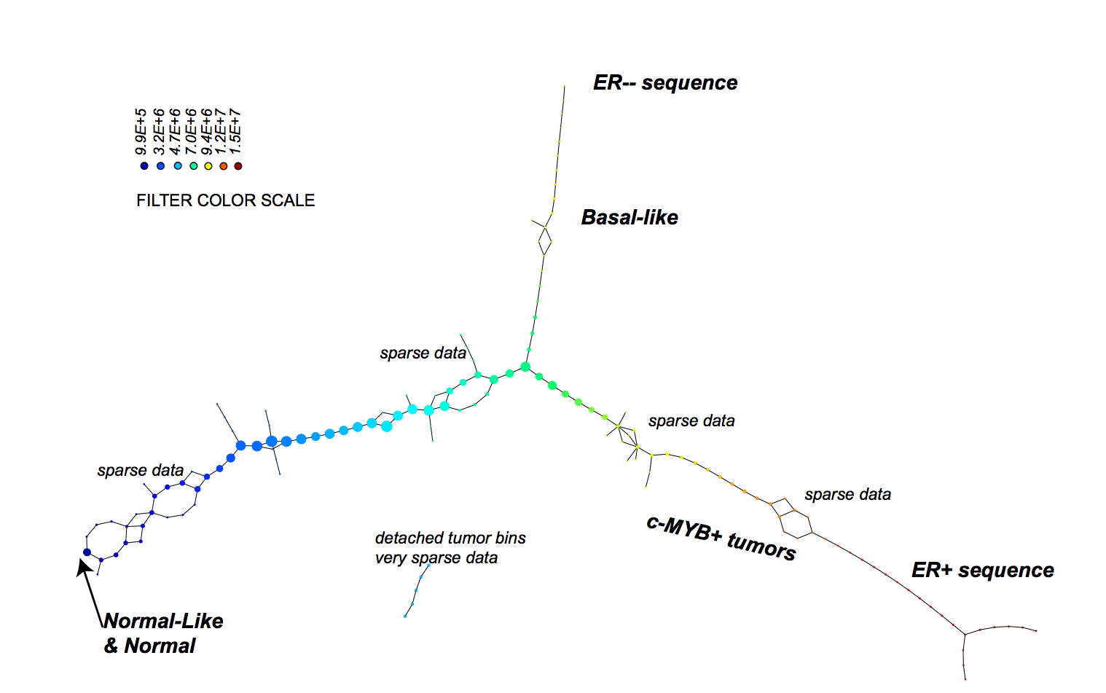
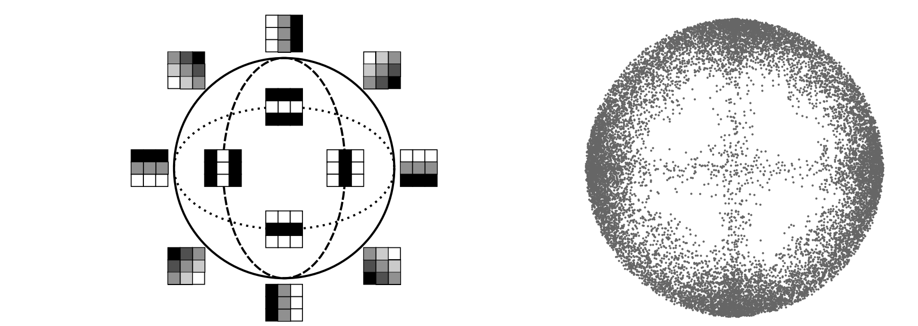
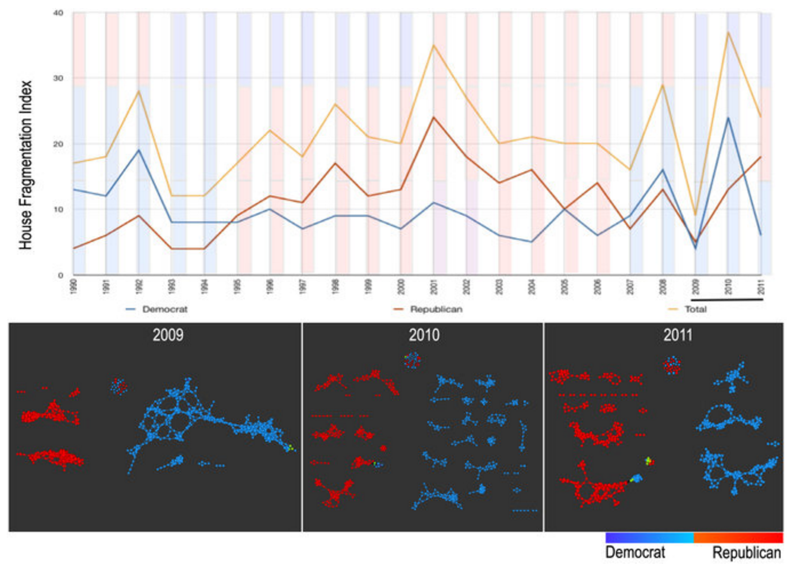
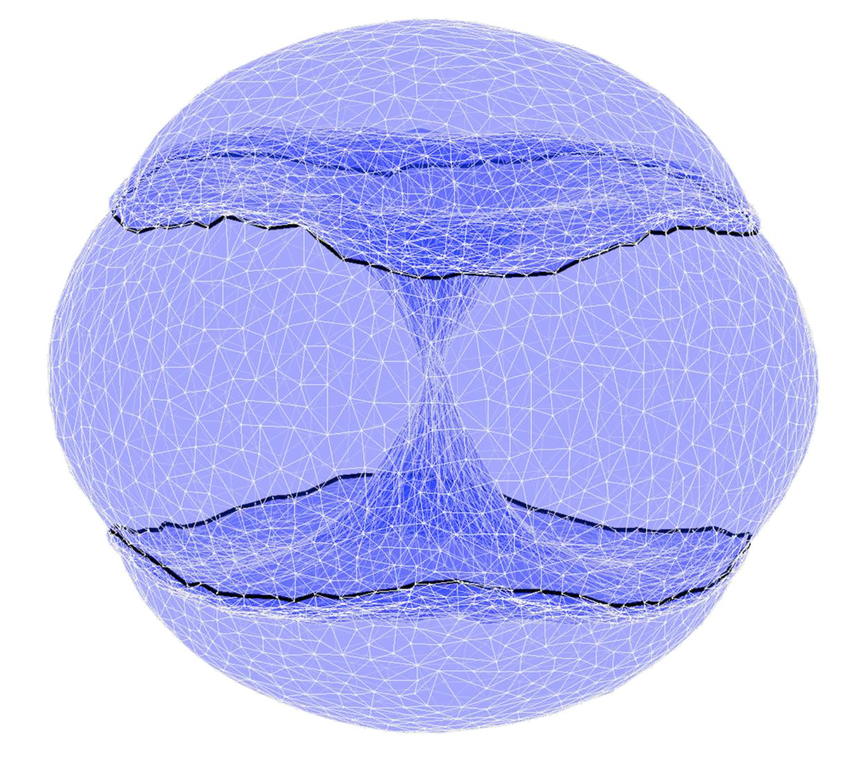
Examples of successes:
G Carlsson et al. International Journal of Computer Vision, 2008.
M Nicolau et al. PNAS, 2011.
P Y Lum et al. Scientific Reports, 2013.
S Martin, JP Watson. Computational Geometry, 2011.

Slide 10
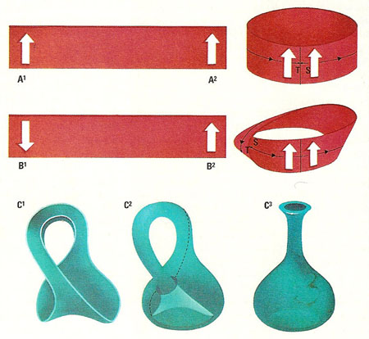
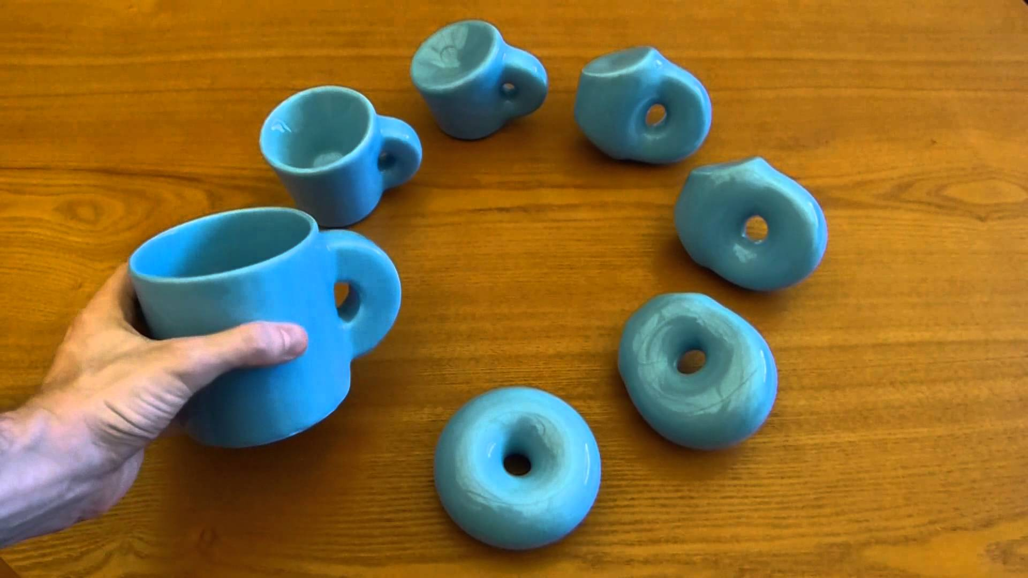
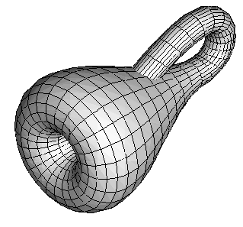
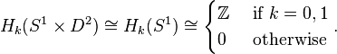
How does it work? What is topology?
Topology studies space and shape, allowing for continuous deformation.
Algebraic topology uses algebra to understand topology.
Notes:
Give history a little. Shape removed from distance is interesting.
Topology: Give example of shapes of letters, what is equivalent to what.
Alg Top: Homology is a functor.
H_0, H_1 interpretations. Some examples.

Slide 11
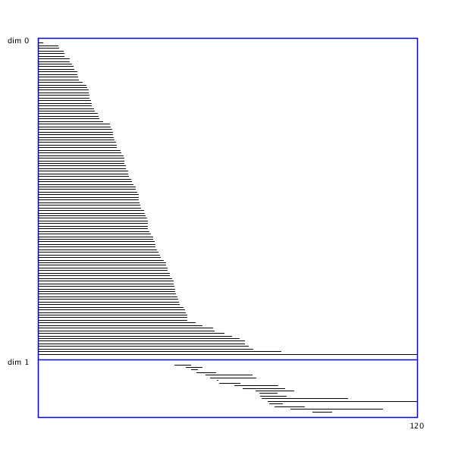
Most common method in TDA: persistent homology
Point cloud X
Fatten X via r
Vietoris-Rips complex VR(X,r)
Take homology
Visualize in barcode
Notes:
Move over to look at data sets.

Slide 12
Demo using Processing…

Slide 13
Most common method in TDA: persistent homology
Point cloud X
Fatten X via r
Vietoris-Rips complex VR(X,r)
Take homology
Visualize in barcode

Slide 14
“Choose your own adventure” time:
Stability theorems: How do we know barcodes are telling us anything?
Revisit some of the applications: How has TDA been used?
The category of barcodes: What additional structure can we add to barcodes?
Where do high-dimensional bubbles come from?
Big picture: What does this mean for me and my life?

Slide 15
Examples of successes:
G Carlsson et al. International Journal of Computer Vision, 2008.
M Nicolau et al. PNAS, 2011.
P Y Lum et al. Scientific Reports, 2013.
S Martin, JP Watson. Computational Geometry, 2011.

Slide 16
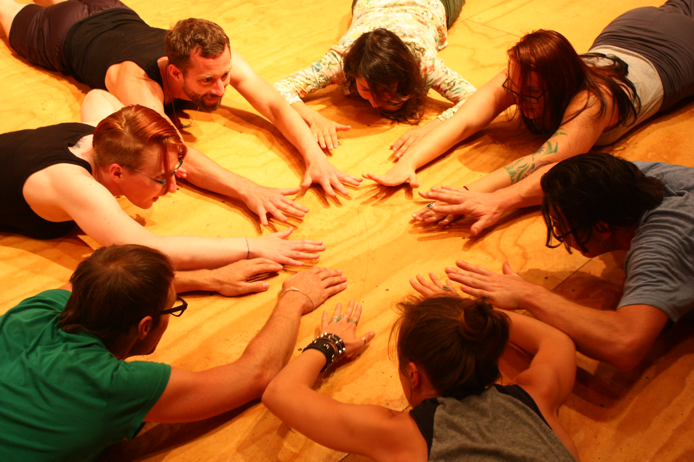
The End.
Thank you!

